Slide 1

Analyze and Implement Text and Graph Mining Application
Submitted By: Marwan Al Farah
Submitted to: Eng. Bassam Kasasbeh

Slide 2
Data Mining
It is the process of uncovering patterns, correlations, and insights from massive volumes of data using various methodologies. It entails obtaining and analyzing data from numerous data sources in order to transform it into usable information. This process aids in the identification of patterns, the prediction of future outcomes, and the formulation of data-driven choices. Data mining is commonly used to identify hidden patterns and correlations in data in industries such as business, research, engineering, and healthcare.
(Stedman and Hughes, 2022; Twin, 2023)

Slide 3
Historical Background of Data Mining
(Coenen, 2011; Exastax, 2017; Li, 2017; javapoint, 2021; Rapid Business Intelligence Success, 2021; Savaş, 2021; Rutgers Bootcamps, 2022; Stedman and Hughes, 2022; Mishra, 2023; Twin, 2023)

Slide 4
Historical Background of Data Mining Early Beginnings (Pre-1960s)
Foundational Concepts: The groundwork for data mining was laid by early mathematicians and statisticians like Thomas Bayes, Carl Friedrich Gauss, and Francis Galton. They developed essential statistical techniques like probability theory, regression analysis, and correlation.
Computational Tools Emerge: The invention of early computers like ENIAC and UNIVAC in the mid-20th century provided the computational power necessary to handle larger datasets and perform complex calculations.

Slide 5
Historical Background of Data Mining 1960s and 1970s
Machine Learning Takes Root: The field of machine learning emerged with pioneers like Frank Rosenblatt's Perceptron algorithm and Arthur Samuel's checkers-playing program. These early examples laid the foundation for machine learning algorithms used in modern data mining.
Database Management Systems (DBMS): The development of DBMS like IBM's System R and Oracle Database facilitated efficient data storage and retrieval, making it easier to manage and analyze large datasets.
Statistical Techniques Advance: New statistical methods like decision trees and linear discriminant analysis were developed, providing further tools for data exploration and prediction.

Slide 6
Historical Background of Data Mining 1980s
Knowledge Discovery in Databases (KDD): The concept of KDD, encompassing the entire process of extracting knowledge from data, was formally introduced. This broader framework emphasized the importance of data preparation, model selection, and interpretation of results.
Rise of Data Mining Tools: Early data mining tools like SAS Enterprise Miner and IBM Intelligent Miner emerged, making data analysis more accessible to a wider audience.
Commercial Applications: The potential of data mining was recognized by businesses, with early applications in areas like credit card fraud detection and customer segmentation.

Slide 7
Historical Background of Data Mining 1990s and 2000s
The Data Mining Boom: The term "data mining" gained widespread popularity, and the field experienced rapid growth. New algorithms like neural networks and support vector machines were developed, leading to improved accuracy and performance.
Democratization of Data Mining: Open-source data mining tools like Weka and R made data analysis accessible to a broader range of users, including researchers and non-experts.
Big Data Era Dawns: The emergence of the internet and other digital technologies led to an explosion in data volume, creating new challenges and opportunities for data mining.

Slide 8
Historical Background of Data Mining Early 2010s
Big Data's Arrival: The term "Big Data" became a buzzword, highlighting the challenges and opportunities associated with massive datasets.
MapReduce and Hadoop: The Google-developed MapReduce framework and the Apache Hadoop ecosystem emerged to enable distributed processing of large datasets.
NoSQL Databases: NoSQL databases like Cassandra and MongoDB gained traction, offering flexibility and scalability for managing diverse data formats.

Slide 9
Historical Background of Data Mining Mid 2010s
Deep Learning Revolution: Deep learning algorithms like convolutional neural networks (CNNs) and recurrent neural networks (RNNs) achieved breakthroughs in image recognition, natural language processing, and other areas.
Spark and Cloud Computing: Apache Spark emerged as a powerful alternative to MapReduce, offering faster and more general-purpose data processing capabilities. Cloud platforms like AWS, Azure, and Google Cloud Platform provided readily available computing resources for data analysis.
Machine Learning Democratization: Machine learning platforms like TensorFlow and PyTorch made deep learning more accessible, leading to a surge in user-created models and applications.

Slide 10
Historical Background of Data Mining Late 2010s and Beyond
Focus on Explainable AI (XAI): Increasing concerns about the transparency and fairness of AI models led to the development of XAI techniques that explain how models make decisions.
Responsible AI and Ethics: Ethical considerations regarding data privacy, bias, and discrimination in AI algorithms received greater attention.
Rise of Edge Computing: Edge computing solutions emerged to process data closer to the source, offering benefits in areas like real-time analytics and Internet of Things (IoT) applications.
DataOps and MLOps: DataOps and MLOps practices gained traction to streamline and automate the data mining workflow, ensuring continuous integration and delivery of models.

Slide 11
Theoretical Background of Data Mining
(Garg, Agrawal and Goyal, 2018; Ibrahim and Tayo, 2020; Skedsoft, 2020; AltexSoft, 2021; Ginni, 2022; TAMIU, 2022; Vijay Kanade, 2022; SoftwareTestingHelp, 2023)

Slide 12
Theoretical Background of Data Mining
Statistics
It plays a foundational role in data mining. It provides the necessary tools for data description, summarization, and inference. Techniques like regression analysis, hypothesis testing, and variance analysis help in understanding the patterns found in large datasets.
1
Machine Learning
It is a critical component of data mining. It involves developing algorithms that allow computers to learn from and make predictions or decisions based on data. It will be discussed more in detail later in the presentation.
2
Database Systems
Data mining often involves dealing with large amounts of data. Database systems provide the infrastructure for efficient data storage, retrieval, and management. Knowledge of database query languages like SQL, data warehousing, and data preprocessing is essential for effective data mining.
3
Pattern Recognition
This involves identifying regularities and irregularities in data. Techniques from pattern recognition are used to detect and interpret patterns and trends in data mining.
4

Slide 13
Theoretical Background of Data Mining
5
6
7
8
Artificial Intelligence (AI)
AI techniques, particularly those involving reasoning and decision-making under uncertainty, are integral to advanced data mining applications. This includes knowledge representation and the use of expert systems.
1
Computational Complexity
Understanding the computational complexity of algorithms is crucial in data mining, as it affects the scalability and efficiency of data processing, especially with large datasets.
2
Algorithm Development
This involves the creation of new algorithms or the adaptation of existing ones to find patterns in data. This often requires a blend of techniques from the aforementioned fields.
3
Ethical and Privacy Considerations
With the increasing capability to mine massive datasets, issues of privacy, data security, and ethical use of data have become central to the field. Understanding these concerns is crucial for responsible data mining.
4

Slide 14
Theoretical Background of Data Mining Challenges and Future Direction
Scalability and Efficiency with Big Data
Adapting to the challenges posed by the enormous volume and complexity of big data through the development of scalable, efficient algorithms and the use of advanced technologies like distributed computing and cloud-based solutions.
Data Quality and Complex Data Types
Improving techniques for data preprocessing and quality assurance, along with developing new methods to handle complex and unstructured data types such as multimedia, social media, and real-time streaming data.
Privacy, Security, and Ethical Concerns
Addressing privacy and security issues through advanced methods like differential privacy and encryption, while also focusing on ethical data mining practices to prevent biases and ensure responsible use of data.
Integration with AI and Explainability
Merging data mining with AI and machine learning, particularly in developing interpretable and explainable models, to enhance decision-making processes in various fields and ensure transparency and trustworthiness. Also, gen AI is an emerging trend in data mining.
Real-time Data Mining and Automation
Advancing real-time data mining for instant insights and focusing on automation technologies like autoML to make data mining accessible to a broader range of users, enhancing efficiency and democratizing data analysis capabilities.
(G, 2020; Lu and Zhu, 2020; Ahmad, 2023; Partida, 2023; Saif, 2023)

Slide 15
Data Mining Tools
(Hillier, 2022; Vijay Kanade, 2022; Wolff, 2022; Javatpoint, 2023)

Slide 16
Data Mining Tools
RapidMiner: An environment for machine learning, data mining, text mining, predictive analytics, and business analytics. It's used for research, education, training, rapid prototyping, and application development and supports all steps of the data mining process.
WEKA (Waikato Environment for Knowledge Analysis): A popular suite of machine learning software written in Java, developed at the University of Waikato. It's free software and is very useful for data preprocessing, classification, regression, clustering, association rules, and visualization.
KNIME (Konstanz Information Miner): A free and open-source data analytics, reporting, and integration platform. KNIME integrates various components for machine learning and data mining through its modular data pipelining concept. It's a powerful tool for building and deploying data analytics applications.
Orange: An open-source data visualization and analysis tool for both novice and expert users. With its interactive visualizations, it is used for data analysis and machine learning.

Slide 17
Data Mining Tools
Tableau: Known for its data visualization capabilities, Tableau also offers powerful data mining functionalities. It's user-friendly and allows users to connect to various data sources.
Microsoft SQL Server Analysis Services (SSAS): A part of Microsoft SQL Server, SSAS is a tool used for online analytical processing (OLAP) and data mining.
Apache Mahout: A distributed linear algebra framework and mathematically expressive Scala DSL designed to let mathematicians, statisticians, and data scientists quickly implement their own algorithms.
SAS (Statistical Analysis System): A software suite developed by SAS Institute for advanced analytics, multivariate analysis, business intelligence, data management, and predictive analytics. It's widely used in industry.

Slide 18
Data Mining Tools
Python
Python stands out in data mining for its simplicity and diverse library ecosystem. Libraries like Pandas, NumPy, Scikit-learn, TensorFlow, and Matplotlib make it ideal for tasks ranging from simple data analysis to complex machine learning projects. Its straightforward syntax appeals to both beginners and experts, making it a top choice in both academia and industry. Python's robust capabilities and active community support ensure its continued relevance in data mining and analytics.
R
R is a powerful language for statistical computing and graphics, widely used in data mining. It offers numerous statistical and graphical methods, supported by packages such as ggplot2, dplyr, caret, and tidyr. R excels in exploratory data analysis and data visualization, making it a favorite among statisticians and data analysts. Its open-source nature and strong community backing make it a comprehensive tool for sophisticated data analysis tasks.

Slide 19

Jormaco
Joramco, a leading organization in the aviation industry, specializes in Maintenance, Repair, and Overhaul (MRO) services for commercial aircraft. With its state-of-the-art facilities in Jordan, Joramco is renowned for its commitment to excellence, safety, and reliability.

Slide 20
Interview
Name
Muath Sarayrah
LinkedIn Profile
Muath D. Sarayrah
Email
msarayreh@joramco.com.jo
Phone Number
+962 7 9750 0508

Slide 21
Traditional Data Mining Approaches
In the initial stages, around 2008, Joramco’s data mining techniques were elementary, heavily reliant on basic databases and simple applications (such as Excel). The cornerstone of this era was Maintenex, a web application based on an Oracle Database, primarily used for tracking labor and material costs in aircraft maintenance.
During that time the data mining approach was straightforward, focusing on basic data collection and minimal processing. Extensive manual intervention was required, from data extraction to report generation, often using basic tools like Excel. Data mining was utilized for generating operational reports, primarily focusing on labor hours and material usage, with limited scope for strategic decision-making.
The methods provided superficial insights, lacking the depth required for complex decision-making, and the heavy reliance on manual processes was time-consuming and prone to human error. Additionally, as the organization grew, these methods became increasingly inadequate due to their inability to handle large volumes of data effectively.

Slide 22
Building Blocks of Traditional Approach
Manual Data Collection and Management: Involving the collection of data through manual processes or basic computer applications. Data was often stored in simple databases or even in physical formats.
Basic Database Systems: Utilizing simple database systems like Oracle Database for data storage. These systems provided basic functionalities for data management but lacked advanced analytical tools.
Manual Report Generation: Reports were manually created by accessing databases, extracting relevant data, and then compiling it in tools like Excel. This process was time-consuming and prone to errors.
Limited Data Integration: Data from various sources (like HRMS, Time Attendance Systems) were not fully integrated, leading to challenges in obtaining a holistic view of operations.
Basic Data Analysis: The focus was primarily on generating reports for management, often centered around key performance metrics like labor hours and material costs. Advanced analytics was minimal or non-existent.

Slide 23
Transitional Phase to Modern Data Mining
The evolution towards a more sophisticated data mining approach began with the integration of SQL Server Reporting Services. This tool marked a significant shift by automating several processes that were previously manual.
Automation in report generation and data extraction processes marked a significant improvement in efficiency as departments were provided with customized access to reports through live dashboards, enhancing real-time data availability. This period also saw the initial steps towards integrating various systems into a more cohesive data structure.

Slide 24
Modern Data Mining Approaches
Joramco’s current data mining landscape is characterized by the use of advanced tools like Tableau and Microsoft Power BI, highlighting a significant leap in data handling capabilities.
The use of Tableau and Power BI for data visualization and business intelligence has enabled deeper insights and more complex data analysis.
The development of a data warehouse using SQL Server Integration Service and Analysis Service has allowed for more integrated and sophisticated data analysis.
Modern data mining at Joramco is now more aligned with specific business needs, focusing on optimizing operational efficiency in MRO activities.

Slide 25
Modern Data Mining Approaches
The modern approach allows for a more nuanced understanding of data, supporting strategic decision-making.
The ability to integrate and analyze data from various sources provides a more holistic view of operations.
Modern tools offer scalability and flexibility, accommodating the growing and changing needs of the organization.
The advanced systems require more sophisticated skills for data management and analysis.
As the complexity of data integration increases, maintaining data quality and consistency becomes more challenging.

Slide 26
Building Blocks of Modern Approach
Automated Data Collection: Utilizing automated systems for collecting data directly from various sources, including sophisticated software applications. This increases the accuracy and speed of data collection.
Advanced Database Systems: Transitioning to more advanced systems like SQL Server, which offer better performance, security, and scalability compared to traditional databases.
SQL Server Reporting Services (SSRS): This tool allowed for the automated generation of reports. It could connect to various data sources and enabled users to write code, build reports, and publish them on dashboards for easy access.
Data Warehousing: Implementing a data warehouse to integrate data from multiple sources into a single repository. This facilitates better data management and analysis.
Data Visualization Tools: Adopting tools like Tableau and Microsoft Power BI for advanced data visualization and business intelligence. These tools help in transforming complex data sets into understandable and actionable insights.
Enhanced Decision Making: Using the insights obtained from advanced data analysis to make informed decisions, improve efficiency, and reduce costs.
Continuous Evolution: Keeping up with the latest trends and technologies in data analytics to ensure the best possible outcomes for the organization.
ETL Processes: Utilizing Extract, Transform, Load (ETL) processes to efficiently move and process data from various sources into the data warehouse.
Business-Specific Analytics: Focusing on analytics that are tailored to specific business needs, such as optimizing planned and actual hours in MRO operations.

Slide 27
Data Mining Benefits
Enhanced Decision-Making: Through data mining, Joramco can extract actionable insights from large datasets, aiding in informed decision-making. This process allows the organization to base its strategies and operations on data-driven insights rather than intuition or incomplete information.
Improved Efficiency and Productivity: By analyzing historical data, Joramco can optimize its operations. For instance, comparing planned versus actual hours worked on aircraft maintenance tasks helps them identify inefficiencies and streamline processes. This results not only in time savings but also in improved workforce productivity.
Cost Reduction: Data mining helps in identifying unnecessary expenditures. As Muath mentioned, an instance of ordering a $50K part that wasn't used was identified through data mining, leading to more prudent spending. Regular analysis of such data can prevent wasteful expenditures and contribute to significant cost savings over time.
Enhancing Operational Processes: By integrating data from various systems (like HRMS, Maintenex, and Time Attendance Management System) into a data warehouse, Joramco gets a holistic view of its operations. This integration allows for better coordination across departments and more effective management of resources.

Slide 28
Data Mining Benefits
Customized Reporting and Dashboards: With tools like SQL Server Reporting Services and visualization tools like Tableau and Power BI, Joramco can create customized reports and dashboards. This customization means that different departments can access relevant data in real-time, tailored to their specific needs and roles within the organization.
Predictive Maintenance and Planning: Although not currently utilizing AI, the groundwork laid by their existing data mining practices positions Joramco to potentially implement predictive maintenance in the future. This approach could preemptively identify maintenance needs, thereby reducing downtime and extending the life of aircraft components.
Employee Empowerment: As mentioned by Muath, data mining has led to a scenario where employees can access their data cubes and customize their dashboards. This empowerment leads to a more informed workforce capable of making better decisions in their respective roles.
Customer Satisfaction and Compliance: In aviation, meeting regulatory standards and customer expectations is crucial. Data mining helps ensure that maintenance tasks are completed within stipulated timelines and to the required standards, enhancing customer trust and regulatory compliance.

Slide 29
LO1 References
Ahmad, M. (2023) Top 10 mining trends in 2023, Mining Digital. Available at: https://miningdigital.com/top10/top-10-mining-trends-in-2023
AltexSoft (2021) Data Science, AI, ML, Deep Learning, and Data Mining, AltexSoft. Available at: https://www.altexsoft.com/blog/data-science-artificial-intelligence-machine-learning-deep-learning-data-mining/
Coenen, F. (2011) ‘Data mining: Past, present and future’, Knowledge Engineering Review, 26(1), pp. 25–29. Available at: https://doi.org/10.1017/S0269888910000378.
Exastax (2017) The History Of Data Mining, Medium. Available at: https://medium.com/@exastax/the-history-of-data-mining-d2aeb0f587ce
G, S. (2020) Explainable AI: Interpretation & Trust in Machine Learning Models, Towards Data Science. Available at: https://towardsdatascience.com/explainable-ai-interpretability-of-machine-learning-models-412840d58f40
Garg, M., Agrawal, S. and Goyal, D. (2018) ‘Theoretical Study on Big Data with Data Mining’, SSRN Electronic Journal, (302017), pp. 1008–1010. Available at: https://doi.org/10.2139/ssrn.3174732.
Ginni (2022) What is the theoretical foundations of Data Mining?, TutorialsPoint. Available at: https://www.tutorialspoint.com/what-is-the-theoretical-foundations-of-data-mining
Hillier, W. (2022) What Are the 7 Best Data Mining Tools of 2023?, Career Foundry. Available at: https://careerfoundry.com/en/blog/data-analytics/best-data-mining-tools/
Ibrahim, M. and Tayo, D.O. (2020) ‘Data Mining: Theory, Concept and Techniques’, International Journal of Science and Advanced Innovative Research [Preprint].
javapoint (2021) History of Data Mining, Javatpoint. Available at: https://www.javatpoint.com/history-of-data-mining
Javatpoint (2023) Data Mining Tools -, Javatpoint. Available at: https://www.javatpoint.com/data-mining-tools
Li, R. (2017) History of data mining, Hacker Bits. Available at: https://hackerbits.com/data/history-of-data-mining/
Lu, W. and Zhu, K.Q. (2020) Trends and Applications in Knowledge Discovery. Springer. Available at: https://doi.org/10.1007/978-3-030-60470-7.

Slide 30
LO1 References
Mishra, L. (2023) Data Mining: History, Techniques, Advantages, and Example, adaptiveus. Available at: https://www.adaptiveus.com/blog/business-analyst/technique/data-mining/
Partida, D. (2023) 5 Data Mining Trends in 2023, Datamation. Available at: https://www.datamation.com/big-data/data-mining-trends/
Rapid Business Intelligence Success (2021) Data Mining History, Rapid Business Intelligence Success. Available at: http://www.rapid-business-intelligence-success.com/data-mining-history.html
Rutgers Bootcamps (2022) What Is Data Mining? A Beginner’s Guide, Rutgers Bootcamps. Available at: https://bootcamp.rutgers.edu/blog/what-is-data-mining/
Saif, Z. (2023) A Guide to Automated Machine Learning (AutoML), Medium. Available at: https://medium.com/@zakariasaif/a-guide-to-automated-machine-learning-automl-8db29c233595
Savaş, D.S. (2021) History of Data Mining, Veri Madenciliği. Available at: https://medium.com/veri-madenciliği/history-of-data-mining-e3117315a81c
Skedsoft (2020) Theoretical Foundations Of Data Mining, Skedsoft. Available at: https://www.skedsoft.com/books/data-mining-data-warehousing/theoretical-foundations-of-data-mining
SoftwareTestingHelp (2023) Difference in Data Mining Vs Machine Learning Vs Artificial Intelligence, SoftwareTestingHelp. Available at: https://www.softwaretestinghelp.com/data-mining-vs-machine-learning-vs-ai/
Stedman, C. and Hughes, A. (2022) What is Data Mining?, TechTarget. Available at: https://www.techtarget.com/searchbusinessanalytics/definition/data-mining
TAMIU (2022) Data Mining Ethics at TAMIU Online, TAMIU. Available at: https://online.tamiu.edu/programs/business/ms-information-science/ethics-of-data-mining/
Twin, A. (2023) What Is Data Mining? How It Works, Benefits, Techniques, and Examples, Investopedia is part of the Dotdash Meredith publishing family. Available at: https://www.investopedia.com/terms/d/datamining.asp
Vijay Kanade (2022) Data Mining: Definition, Techniques, and Tools, Spiceworks. Available at: https://www.spiceworks.com/tech/big-data/articles/what-is-data-mining/
Wolff, R. (2022) 10 Best Data Mining Tools in 2022, MonkeyLearn Blog. Available at: https://monkeylearn.com/blog/data-mining-tools/

Slide 31
Text Mining
Text mining, also known as text data mining or text analytics, is the process of deriving meaningful information from text. This involves transforming unstructured text into structured data for analysis, exploration, and further processing. Text mining is a multidisciplinary field based on information retrieval, data mining, machine learning, statistics, and computational linguistics.
(IBM, 2020; MonkeyLearn, 2020; Stedman, 2021)

Slide 32
Real Word Text Mining Examples
Customer Feedback Analysis
Businesses use text mining to analyze customer reviews and feedback. By processing large amounts of textual data from reviews, companies can identify common complaints, praises, or requests, helping them improve their products or services.
Social Media Monitoring
Analyzing social media posts to gauge public opinion on certain topics, track trends, and understand customer preferences. This involves sentiment analysis to determine the general mood or opinion expressed in these posts.
Academic Research
Researchers use text mining to analyze large volumes of academic papers and literature. This can help in identifying research trends, finding relevant literature, and understanding the evolution of a particular field.
Financial Market Analysis
Analyzing news articles, financial reports, and social media posts to predict stock market trends or understand economic indicators.
(Jeor, 2020; St. Jeor, 2020; Expert.ai Team, 2022)

Slide 33
General Text Mining Concepts
Text Preprocessing: The process of cleaning and preparing raw text for analysis. It involves tokenization, removing stop words, and normalizing text.
Feature Extraction: Transforming text into a format suitable for machine learning, using methods like Bag of Words, TF-IDF, and word embeddings.
Data Mining and Machine Learning Techniques: Applying algorithms to discover patterns, classify, or predict outcomes in text, including classification, clustering, and pattern recognition.
Advanced Techniques: Incorporating sophisticated methods like Natural Language Processing and Deep Learning to analyze and understand complex language patterns.
Visualization and Interpretation: Creating visual representations of text mining results and interpreting these results to derive insights and conclusions.
Integration and Real-world Application: Implementing text mining insights into practical applications across various fields, enhancing decision-making, and analytics processes.

Slide 34
Algorithms and Examples in Text Mining
Natural Language Processing (NLP)
Used for understanding, interpreting, and manipulating human language. This includes tasks like sentiment analysis which uses SVM or Naïve Bayes, topic modeling which uses LDA or NMF, and entity recognition which uses CRFs or RNN in NER.
Text Analytics Algorithms
Such as keyword extraction, which identifies the most relevant words or phrases in a text, Text Summarization, or Text ClassIfication. One example is the TF-IDF.
Classification Algorithms
These algorithms categorize text data into predefined classes. Popular examples include Naive Bayes, Support Vector Machines (SVM), and Random Forest.
Clustering Algorithms
These algorithms group text data into clusters based on their similarities. Common clustering algorithms include K-means, Hierarchical clustering, and Density-based spatial clustering of applications with noise (DBSCAN).
Association Rule Learning
This technique identifies frequent patterns and relationships between words or phrases in text data. The Apriori algorithm is a popular example.
Topic Modeling
This technique automatically identifies topics or themes discussed in a collection of documents. Probabilistic Latent Dirichlet Allocation (PLDA) and Latent Semantic Analysis (LSA) are prominent examples.
(Ohri, 2021; Valcheva, 2022)

Slide 35
Algorithms and Examples in Text Mining (Embeddings)
BERT (Bidirectional Encoder Representations from Transformers)
Developed by Google, BERT excels in understanding the context of words by analyzing surrounding text. It's highly effective for tasks like question answering and language inference, utilizing deep learning techniques.
GloVe (Global Vectors for Word Representation)
A creation of Stanford University, GloVe generates word embeddings by examining word co-occurrences globally in a corpus. It effectively captures word meanings and relationships.
GPT (Generative Pretrained Transformer)
From OpenAI, GPT models are known for their human-like text generation. They're pretrained on extensive text data and can be fine-tuned for specific NLP tasks, showcasing versatility.
Word2Vec
This Google innovation uses shallow neural networks to produce word embeddings. Word2Vec is notable for its ability to capture semantic meanings of words and is widely applied in various NLP tasks.
ELMo (Embeddings from Language Models)
Developed by the Allen Institute for AI, ELMo provides deep contextualized word representations. It effectively captures word meanings in different contexts, surpassing traditional embeddings in complexity.
FastText
From Facebook’s AI Research lab, FastText enhances Word2Vec by understanding subword information through character n-grams. This is particularly beneficial for processing morphologically rich languages or unfamiliar words.
(Kathrani, 2020; Burke, 2021; Dave, 2023)

Slide 36
Methods in Text Mining
Natural Language Processing
This is a foundational aspect of text mining that involves the use of algorithms to understand and manipulate human language. NLP techniques enable the system to perform tasks like sentiment analysis, topic modeling, and language translation.
Large Language Models
These are advanced forms of NLP models, typically trained on vast amounts of text data. They can generate human-like text, answer questions, summarize documents, and perform various other tasks. Examples include OpenAI's GPT models and Google's BERT.
Text Classification and Categorization
This involves assigning predefined categories or labels to text. It's useful in applications like spam detection, content categorization, and sentiment analysis.
Topic Modeling
Topic modeling algorithms like Latent Dirichlet Allocation (LDA) are used to discover abstract topics within a collection of documents. They help in understanding the underlying themes in large text corpora.
Information Extraction
This process involves extracting structured information from unstructured text, such as entities (names, places, organizations), relationships between entities, and specific facts or events.
(Nishida, 2016; Savale, Savale and Gharpure, 2018; Rai, 2019; Kerner, 2020; Tyagi Neelam, 2021; DataScientest, 2023; Parashar, 2023)

Slide 37
Approaches in Text Mining
Rule-Based Approaches
Using predefined rules and patterns to analyze text. This is effective for structured tasks like extracting specific information.
Statistical Approaches
Leveraging statistical models to understand patterns and correlations in text data.
Machine Learning-Based Approaches
Using data-driven models that learn from text data to make predictions or classifications.
Hybrid Approaches
Combining multiple techniques and methods, often integrating rule-based and machine learning approaches for more robust text mining.
(IBM, 2020; Bonthu, 2021; Karaoğlan and Fındık, 2022)

Slide 38
Techniques in Text Mining
Preprocessing
This step involves cleaning and structuring text data by removing noise, identifying and correcting errors, and normalizing text format. This includes tasks like tokenization, stop word removal, stemming, and lemmatization.
Feature extraction
This step involves identifying and extracting relevant features from text data that can be used for further analysis. Common features include word frequencies, n-grams, part-of-speech tags, and named entities.
Dimensionality reduction
This step reduces the number of features in high-dimensional text data to improve the efficiency and accuracy of algorithms. Techniques like Principal Component Analysis (PCA) and Non-negative Matrix Factorization (NMF) are commonly used.
Machine learning
Machine learning techniques are often employed for tasks like text classification, sentiment analysis, Information Retrieval, and information extraction. These techniques learn from labeled data to make predictions on new unseen data.
Pattern Recognition
This process involves identifying and extracting specific patterns and structures from text data. It uses algorithms to recognize regularities, such as recurring sequences of words, phrases, or syntactic structures.
(Nishida, 2016; Savale, Savale and Gharpure, 2018; Rai, 2019; Kerner, 2020; Tyagi Neelam, 2021; DataScientest, 2023; Parashar, 2023)

Slide 39
Text Preprocessing
Tokenization
Breaking down text into words, phrases, symbols, or other meaningful elements (tokens).
Stemming and Lemmatization
Reducing words to their base or root form to simplify analysis.
Part-of-Speech Tagging
Identifying each word's role in a sentence (like noun, verb, adjective).
Named Entity Recognition (NER)
Identifying and classifying key information (names of people, places, etc.) in text.
(Fuchs, 2021; Deepanshi, 2023)

Slide 40

TF-IDF
TF-IDF is a statistical measure used to evaluate the importance of a word in a document, which is part of a corpus. It's often used in search engine scoring, text mining, and user modeling. The value increases proportionally to the number of times a word appears in the document, offset by the frequency of the word in the corpus, which helps to adjust for the fact that some words appear more frequently in general.
(Stecanella, 2019; Simha, 2021)

Slide 41
TF-IDF
Term Frequency (TF): This measures how frequently a term occurs in a document. It's calculated by dividing the number of times a term t appears in a document by the total number of terms in that document.
Inverse Document Frequency (IDF): This measures how important a term is. While computing TF, all terms are considered equally important. However, certain terms, like "is", "of", and "that", may appear many times but have little importance. Thus, we need to weigh down the frequent terms while scaling up the rare ones. IDF is calculated as the logarithm of the number of documents divided by the number of documents that contain the term t.
TF-IDF Calculation: It's a product of TF and IDF. A high TF-IDF score indicates a term is more important to a document in a collection, or corpus.
(Stecanella, 2019; Simha, 2021)

Slide 42

Example of TF-IDF
Imagine we have a corpus containing 1000 documents, and the word "apple" appears in 50 of these. The term frequency (TF) for "apple" in a document where it appears 4 times would be 4 divided by the total number of terms in the document. The inverse document frequency (IDF) would be calculated as the logarithm of (1000/50). The TF-IDF score would then be the product of these two figures.

Slide 43
TF-IDF Measures
Euclidean Distance, when applied in conjunction with TF-IDF, calculates the straight-line distance between two document vectors in a multidimensional space. This metric is sensitive to document length, as longer documents can disproportionately influence the distance measure. While it provides a clear geometric interpretation of text data, it may not be ideal in high-dimensional spaces like those typical in text analysis, where distance measures can become inflated and less meaningful.
Manhattan Distance, combined with TF-IDF, sums the absolute differences of the TF-IDF values for each term in the documents. This approach is particularly effective in dealing with sparse data sets, which is a common characteristic of text data. It is also more robust to outliers than Euclidean Distance. In practice, Manhattan Distance is often used in machine learning algorithms and compressive sensing, where axis-aligned distances are more relevant.
Cosine Similarity in the context of TF-IDF measures the cosine of the angle between two document vectors. Its main advantage is that it is independent of the magnitude of the vectors, focusing instead on their orientation, making it an ideal choice for text similarity. This characteristic allows it to effectively determine how similar two documents are in terms of their content, regardless of their length. It's widely used in information retrieval and text analysis applications, where the orientation of the documents in vector space is more significant than their size.
(Ladd, 2020; Langenderfer, 2021)

Slide 44
LO3 References
Bonthu, H. (2021) Rule-Based Sentiment Analysis in Python for Data Scientists, Analytics Vidhya. Available at: https://www.analyticsvidhya.com/blog/2021/06/rule-based-sentiment-analysis-in-python/
Burke, R. (2021) GloVe, ELMo & BERT, Towards Data Science. Available at: https://towardsdatascience.com/glove-elmo-bert-9dbbc9226934
DataScientest (2023) Text mining: Definition, techniques, use cases, DataScientest. Available at: https://datascientest.com/en/text-mining-all-you-need-to-know
Dave, P. (2023) GPT vs BERT: Which is Better?, Towards Data Science. Available at: https://towardsdatascience.com/gpt-vs-bert-which-is-better-2f1cf92af21a
Deepanshi (2023) Text Preprocessing in NLP with Python Codes, Analytics Vidhya. Available at: https://www.analyticsvidhya.com/blog/2021/06/text-preprocessing-in-nlp-with-python-codes/
Expert.ai Team (2022) 10 Practical Text Mining Examples to Leverage Right Now | Expert.ai | expert.ai, Expert.ai. Available at: https://www.expert.ai/blog/10-text-mining-examples/
Fuchs, M. (2021) NLP - Text Pre-Processing III (POS, NER and Normalization), Michael Fuchs Python. Available at: https://michael-fuchs-python.netlify.app/2021/05/31/nlp-text-pre-processing-iii-pos-ner-and-normalization/
IBM (2020) What is Text Mining?, IBM. Available at: https://www.ibm.com/cloud/learn/text-mining
St. Jeor, C. (2020) 5 Real World Text Mining Examples You Can Apply to Your Data, Zencos. Available at: https://www.zencos.com/blog/text-mining-examples-advanced-analytics
Jeor, C. St. (2020) What can businesses learn from text mining?, Semeon. Available at: https://semeon.com/textanalytics/what-can-businesses-learn-from-text-mining/
Karaoğlan, K.M. and Fındık, O. (2022) ‘Extended rule-based opinion target extraction with a novel text pre-processing method and ensemble learning’, Applied Soft Computing, 118, p. 108524. Available at: https://doi.org/10.1016/J.ASOC.2022.108524.
Kathrani, K. (2020) All about Embeddings - Word2Vec, Glove, FastText, ELMo, InferSent and Sentence-BERT, Medium. Available at: https://medium.com/@kashyapkathrani/all-about-embeddings-829c8ff0bf5b
Kerner, S.M. (2020) What are Large Language Models?, TechTarget. Available at: https://www.techtarget.com/whatis/definition/large-language-model-LLM

Slide 45
LO3 References
Ladd, J.R. (2020) ‘Understanding and Using Common Similarity Measures for Text Analysis’, Programming Historian [Preprint], (9). Available at: https://doi.org/10.46430/PHEN0089.
Langenderfer, J. (2021) Using Python to Calculate Similarity Distance Measurement for Text Analysis, Web Mining [IS688, Spring 2021]. Available at: https://medium.com/web-mining-is688-spring-2021/using-python-to-calculate-similarity-distance-measurement-for-text-analysis-efb089cb582f
MonkeyLearn (2020) What Is Text Mining? A Beginner’s Guide, MonkeyLearn. Available at: https://monkeylearn.com/text-mining/
Nishida, K. (2016) Demystifying Text Analytics Part 4 — Dimensionality Reduction and Clustering High Dimensional and Sparse Data, learn data science. Available at: https://blog.exploratory.io/demystifying-text-analytics-part-4-dimensionality-reduction-and-clustering-in-r-cbc8c90e0b14
Ohri, A. (2021) Text Mining Algorithms: A Comprehensive Overview (2021), U-Next. Available at: https://u-next.com/blogs/data-science/text-mining-algorithms/
Parashar, N. (2023) Text Mining: Techniques and Applications, Medium. Available at: https://medium.com/@niitwork0921/text-mining-techniques-and-applications-b3ce61e3441c
Rai, A. (2019) What is Text Mining: Techniques and Applications | upGrad blog, upGrad. Available at: https://www.upgrad.com/blog/what-is-text-mining-techniques-and-applications/
Savale, S., Savale, S.C. and Gharpure, A.A. (2018) ‘Pattern Identification Using Text Mining’, Asian Journal For Convergence In Technology (AJCT) ISSN -2350-1146, 2(2). Available at: https://asianssr.org/index.php/ajct/article/view/201
Simha, A. (2021) Understanding TF-IDF for Machine Learning, Capital One. Available at: https://www.capitalone.com/tech/machine-learning/understanding-tf-idf/
Stecanella, B. (2019) Understanding TF-ID: A Simple Introduction, MonkeyLearn.com. Available at: https://monkeylearn.com/blog/what-is-tf-idf/
Stedman, C. (2021) What is text mining (text analytics)?, TechTarget. Available at: https://www.techtarget.com/searchbusinessanalytics/definition/text-mining
Tyagi Neelam (2021) 7 Text Mining Techniques | Analytics Steps, Analytics Steps. Available at: https://www.analyticssteps.com/blogs/top-7-text-mining-techniques
Valcheva, S. (2022) Text Mining Algorithms List: Text Classification Categorization Clustering, Intellspot. Available at: https://www.intellspot.com/text-mining-algorithms/

Slide 46
Graph Mining
Graph data mining refers to the process of discovering meaningful patterns, structures, and relationships within graph-based data. In this context, a graph consists of nodes (also known as vertices) representing entities, and edges representing the relationships or interactions between these entities. This approach is particularly useful in domains where data can be naturally represented as graphs.
(GeeksforGeeks, 2021; Tatan, 2021)

Slide 47
Graph Mining Examples
Social Network Analysis
In social networks like Facebook or Twitter, graph data mining can be used to understand how individuals interact, identify influential users, or detect communities within the network.
Web Graph Analysis
Analyzing the structure of the web by treating web pages as nodes and hyperlinks as edges. This can help in understanding website authority and the quality of information dissemination.
Bioinformatics
In the study of biological networks such as protein-protein interaction networks, graph data mining can help in identifying significant patterns or interactions that might be crucial for understanding diseases or biological processes.
Fraud Detection in Financial Networks
Banks and financial institutions can use graph data mining to detect unusual patterns in transaction networks, which might indicate fraudulent activity.
Transportation and Logistics
Graph data mining can analyze networks of roads or shipping routes to optimize paths, identify bottlenecks, or improve efficiency.
(Wang, 2020; Agarwal, 2022; The University of Queensland, 2022)
Notes:
Graph data mining is a powerful tool because it leverages the relational information inherent in many types of data. By focusing on the relationships between entities, it can uncover insights that might be missed by other data mining techniques that consider entities in isolation.

Slide 48
How Graph Mining Algorithms Work
Pattern Recognition: These algorithms identify frequent subgraphs or patterns within a larger graph. This involves comparing different parts of a graph to find recurring structures.
1
Clustering and Community Detection: These algorithms group together nodes that have higher connectivity with each other than with the rest of the graph. Techniques like modularity optimization or spectral clustering are often used.
2
Centrality Analysis: These algorithms identify important nodes based on their position in the network. Metrics like degree centrality, betweenness centrality, and closeness centrality are calculated.
3
Link Prediction: This involves predicting the likelihood of a future link between two nodes, based on existing connections and node attributes.
4
Anomaly Detection: Algorithms that identify patterns or nodes that deviate significantly from the norm in a graph, which can indicate fraudulent activities or errors.
5
Network Analysis: Algorithms that help us understand the structure of the network, including properties like centrality, which identifies the most important nodes in a network.
6
(Papers With Code, 2020; Jayawickrama, 2021; Loem, 2021; Qiao et al., 2021; Wang et al., 2021)

Slide 49
Example: K-Means for Graph Clustering
Initialization: Select 'K' nodes as the initial centroids of the clusters. These can be chosen randomly or based on some heuristic.
Assignment: Assign each node to the cluster represented by the closest centroid. In graph terms, this could mean the centroid node with the shortest path or highest similarity to the node in question.
Update: Update the centroids of the clusters. In a graph, this might involve choosing a new centroid that minimizes the total distance (or maximizes total similarity) to all other nodes in the cluster.
Iteration: Repeat the assignment and update steps until the centroids no longer change or the changes are below a certain threshold.
Result: The nodes are divided into 'K' clusters, with each cluster represented by its centroid.
(Sieranoja and Fränti, 2022)

Slide 50
Centrality Measures
PageRank
Identifies the most influential nodes in a network, such as key web pages on the internet.
Highlights nodes that are considered authoritative or credible due to their endorsement (links) by other nodes.
Betweenness Centrality
Nodes with high betweenness centrality can influence the flow of information since they act as key connectors or bridges.
Helps in identifying potential bottlenecks in communication or transportation networks.
Removal of these nodes might significantly disrupt communication within the network.
Closeness Centrality
Nodes with high closeness centrality can efficiently interact with other nodes due to their short path lengths.
These nodes can spread or gather information quickly within the network.
Such nodes can be crucial in controlling or monitoring the flow of information in a network.
Degree Centrality
A high degree centrality indicates a popular or highly active node, like a social media user with many friends or followers.
Nodes with high degree centrality can quickly disseminate information through their direct connections.
(Disney, 2020; Turing, 2021; Erika Varagouli, 2023)
Notes:
Centrality measures in graph mining are crucial for understanding the roles and influences of various nodes within a network. These measures provide insights into the importance, influence, and connectivity of nodes in a graph. Let's discuss four key centrality measures: PageRank, Degree Centrality, Closeness Centrality, and Betweenness Centrality, and the insights they can offer.
PageRank
Overview: Developed by Google founders Larry Page and Sergey Brin, PageRank evaluates the importance of web pages based on the quantity and quality of links to them.
PageRank is particularly useful in ranking nodes in large networks like the World Wide Web.
Betweenness Centrality
Overview: Quantifies how often a node acts as a bridge along the shortest path between two other nodes.
Betweenness Centrality identifies nodes that are crucial for maintaining network connectivity and controlling information flow.
Closeness Centrality
Overview: Measures how close a node is to all other nodes in the network, considering the shortest paths.
Closeness Centrality gives an idea of how efficiently a node can spread information through the network.
Degree Centrality
Overview: Measures the number of direct connections a node has.
Degree Centrality offers a basic understanding of the most connected nodes.
Each of these centrality measures provides different insights into the structure and dynamics of a network.
Understanding these measures helps in various applications like social network analysis, web page ranking, network traffic optimization, and identifying key influencers or critical nodes in various types of networks.

Slide 51
Programming Languages and Tools
Python
Libraries: Python is popular due to its rich set of libraries for graph analysis like NetworkX, PyVis, and PyG.
Use Case: Ideal for prototyping, research, and handling moderately sized graphs.
Java
Frameworks: Apache Giraph and JGraphT are commonly used for graph processing in Java.
Use Case: Suitable for enterprise-level applications and handling large-scale graph data.
Scala
Tool: Apache Spark's GraphX module is widely used for big data processing and graph computations.
Use Case: Excellent for distributed computing environments and large datasets.
R
Packages: igraph and ggraph are popular for statistical analysis and visualization of graph data.
Use Case: Good for statistical analysis and exploratory data analysis in academic settings.
Graph Databases
Tools: Neo4j, ArangoDB, and Amazon Neptune are examples of databases optimized for storing and querying graph data.
Use Case: Efficient for applications that require frequent querying and updating of graph data.
Specialized Graph Analytics Platforms
Examples: Gephi for visualization, TigerGraph, and GraphLab for advanced analytics.
Use Case: These platforms offer specialized functionalities like advanced visualization, large-scale data handling, and complex algorithm implementations.
(Apache Giraph, 2020; Gephi, 2020; (Dimid), 2022; AltexSoft, 2023; Bojanowski and Jasny, 2023; Naseem, 2023)
Notes:
In the industry, the choice of language and tool often depends on the specific requirements of the project, such as the size of the dataset, the complexity of the algorithms needed, and the existing technology stack of the organization. Python, with its ease of use and extensive library support, remains a popular choice for many graph data mining tasks. However, for handling very large datasets or for high-performance requirements, languages and tools like Java with Apache Giraph, or Scala with Apache Spark's GraphX, are often preferred.

Slide 52
LO4 References
(Dimid), D.N. (2022) Graphs with Python, Towards Data Science. Available at: https://towardsdatascience.com/graphs-with-python-overview-and-best-libraries-a92aa485c2f8
Agarwal, L. (2022) Application of Graph Theory in Real Life, Prinsli. Available at: https://prinsli.com/application-of-graph-theory-in-real-life/
AltexSoft (2023) The Good and the Bad of Apache Spark, AltexSoft. Available at: https://www.altexsoft.com/blog/apache-spark-pros-cons/
Apache Giraph (2020) Giraph - Welcome To Apache Giraph!, Apache Giraph. Available at: https://giraph.apache.org/
Bojanowski, M. and Jasny, L. (2023) Introduction to Network Analysis Tools in R, Statnet. Available at: https://statnet.org/workshop-intro-sna-tools/
Disney, A. (2020) Social network analysis: Understanding centrality measures, Cambridge Intelligence. Available at: https://cambridge-intelligence.com/keylines-faqs-social-network-analysis/
Erika Varagouli (2023) Everything You Need to Know about Google PageRank, Semrush. Available at: https://www.semrush.com/blog/pagerank/
GeeksforGeeks (2021) Data Mining Graphs and Networks, GeeksforGeeks. Available at: https://www.geeksforgeeks.org/data-mining-graphs-and-networks/
Gephi (2020) About, Gephi. Available at: https://gephi.org/about/
Jayawickrama, T.D. (2021) Community Detection Algorithms, Towards Data Science. Available at: https://towardsdatascience.com/community-detection-algorithms-9bd8951e7dae

Slide 53
LO4 References
Loem, M. (2021) What is Network Analysis?, Towards Data Science. Available at: https://towardsdatascience.com/network-analysis-d734cd7270f8
Naseem, S. (2023) Understanding Knowledge Graph Stores: A Comprehensive Comparison, Medium. Available at: https://medium.com/@iamshowkath/understanding-knowledge-graph-stores-a-comprehensive-comparison-d7b9248c1ecd
Papers With Code (2020) Link Prediction, Papers With Code. Available at: https://paperswithcode.com/task/link-prediction
Qiao, R. et al. (2021) ‘Graph Pattern Matching: Capturing Bisimilar Subgraph’, International Journal of Pattern Recognition and Artificial Intelligence, 35(3). Available at: https://doi.org/10.1142/S0218001421500117.
Sieranoja, S. and Fränti, P. (2022) ‘Adapting k-means for graph clustering’, Knowledge and Information Systems, 64(1), pp. 115–142. Available at: https://doi.org/10.1007/S10115-021-01623-Y.
Tatan, V. (2021) Understanding Graph Mining, Towards Data Science. Available at: https://towardsdatascience.com/understanding-graph-mining-e713183a64f3
The University of Queensland (2022) Graph Mining and Applications, The University of Queensland. Available at: https://eecs.uq.edu.au/event/session/6903
Turing (2021) Graph Centrality Measures: Types and Explanation., Turing. Available at: https://www.turing.com/kb/graph-centrality-measures
Wang, S. (2020) Introduction to Graph Mining and Analytics, Towards Data Science. Available at: https://towardsdatascience.com/introduction-to-graph-mining-and-analytics-fac18515ea3e
Wang, X. et al. (2021) One-class graph neural networks for anomaly detection in attributed networks, Neural Computing and Applications. Available at: https://doi.org/10.1007/s00521-021-05924-9.

Slide 54
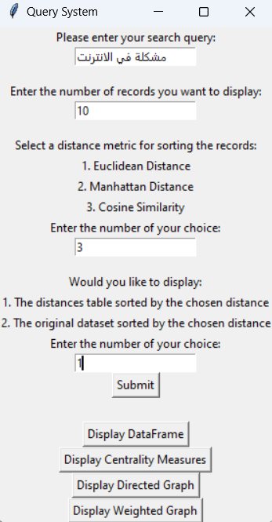
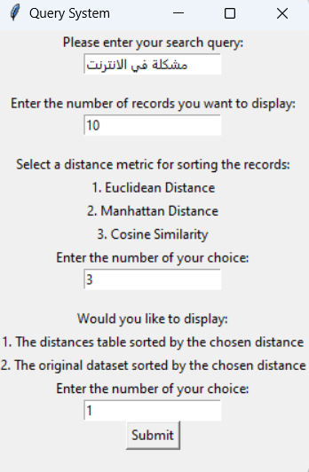
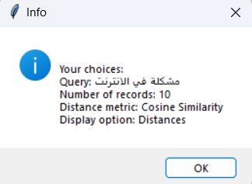
Text and Graph Mining Application

Slide 55
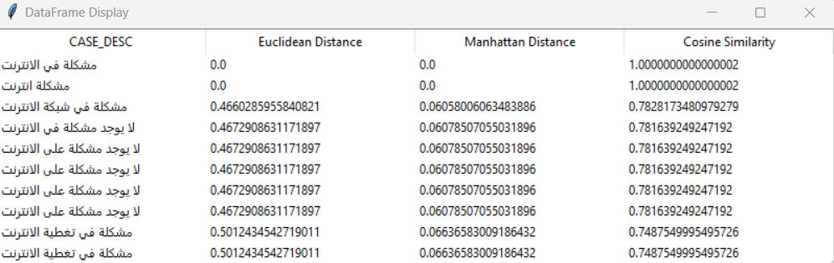
Text and Graph Mining Application

Slide 56
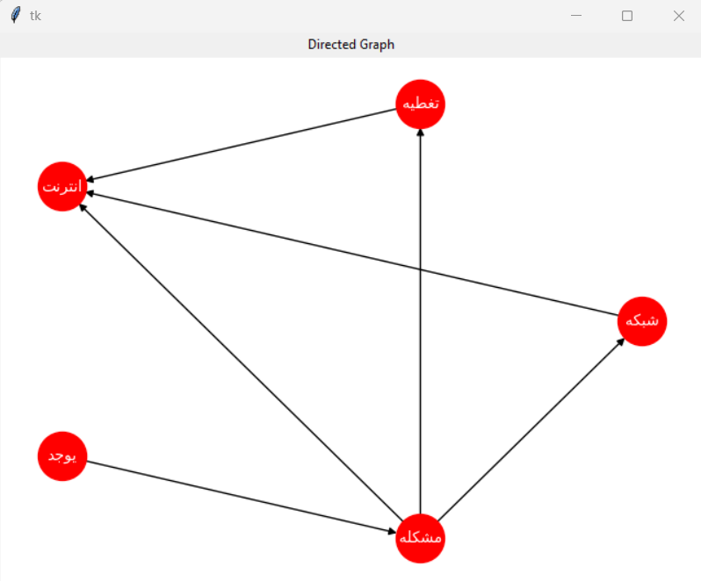
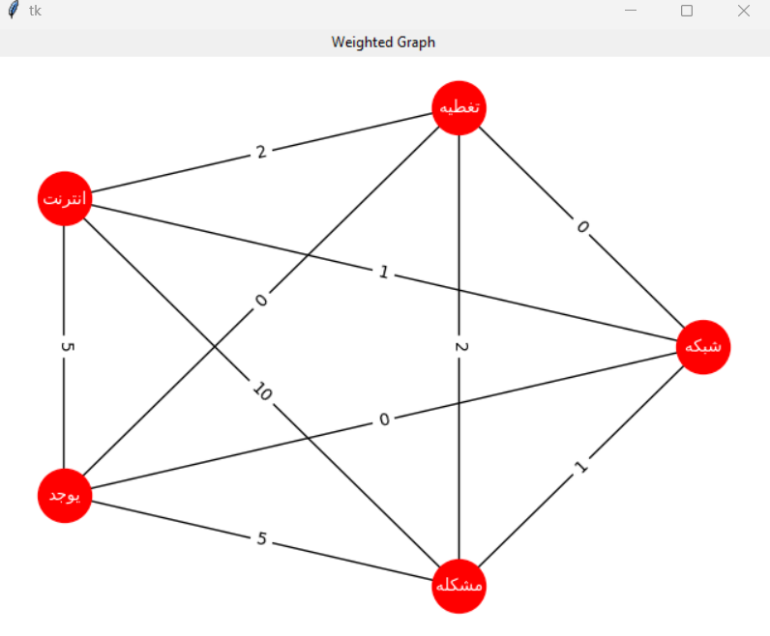
Text and Graph Mining Application

Slide 57
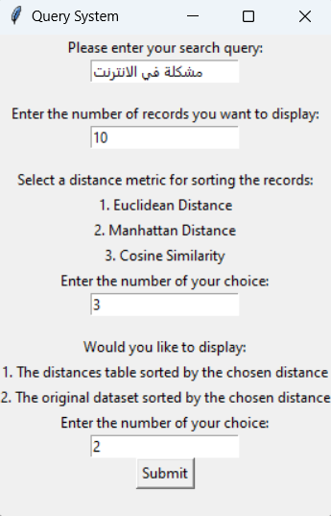
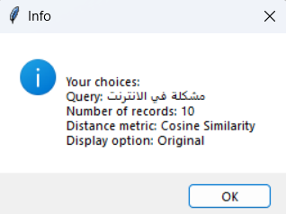
Text and Graph Mining Application

Slide 58
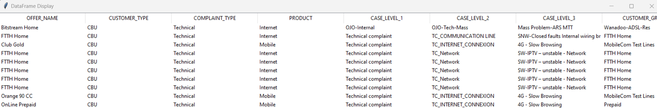
Text and Graph Mining Application

Slide 59

Thank You!

